Slide 1
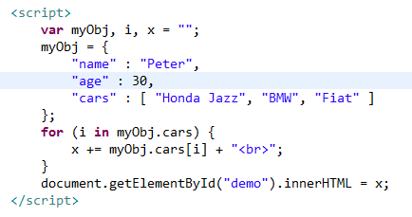
JSON Arrays – for-in loop
We can access array values by using a for-in loop

